Slide 1



Two-way ANOVA in Jamovi Part 1: Introduction
Video: https://screencast-o-matic.com/watch/c3iY1PVZnNW
Ellen Marshall
Statistics support coordinator
Website and resources: https://maths.shu.ac.uk/mathshelp/resources.html

Slide 2
Two way ANOVA
This video covers how to do a two way between groups ANOVA in Jamovi
Two way ANOVA is used to test the main effects of two categorical variables
Interaction/moderation: Does the effect of one variable differ depending on the value of the other?
INDEPENDENTS
2 or more categorical variables
DEPENDENT (outcome) variable: Continuous
affects
Notes:
For comparing means ask two questions:
Are there repeated measurements of the same variable for each participant?
How many means are being compared? 2 = t-test, 3+ = ANOVA

Slide 3
Driving reaction time
Participants were given either alcohol, coffee or water and their reaction time on a driving simulator taken (in seconds)
Alcohol | Coffee | Water
1.69 | 0.98 | 0.37
1.71 | 1.11 | 0.38
1.75 | 1.27 | 0.61
1.83 | 1.32 | 0.78
1.97 | 1.44 | 0.83
2.53 | 1.45 | 0.86
2.66 | 1.46 | 0.9
2.91 | 1.76 | 0.95
3.28 | 2.56 | 1.63
3.47 | 3.07 | 1.97
A one way ANOVA could be used to test whether drink has an effect on driving reaction time
A two-way ANOVA has two categorical independents
Dependent = reaction time
Independents: Drink and gender
Tests 3 hypotheses:
Mean reaction time does not differ by drink
Mean reaction time does not differ by gender
There is no interaction between group and gender

Slide 4
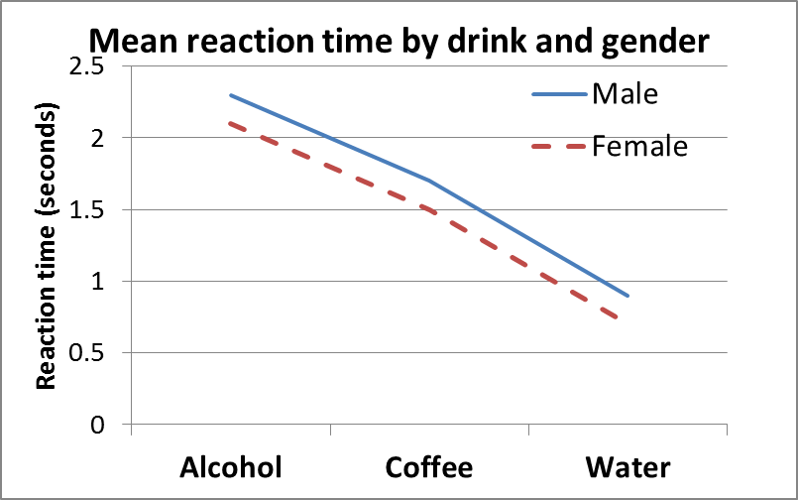
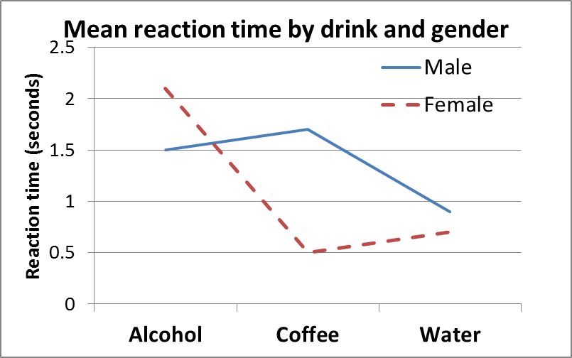
Interaction (means) plot
Mean reaction times after consuming coffee, water and beer were taken and the results by drink or gender were compared.
Mean reaction time for men after water = 0.9
 | Alcohol | Coffee | Water
Male | 2.3 | 1.7 | 0.9
Female | 2.1 | 1.5 | 0.7
Here there is an interaction between drink and gender. The effect of drink differs for males and females. Drink is moderated by gender or vice versa
Notes:
I’m just showing this quickly as you may need it later! Each point is the mean of the combination. If there’s no interaction, the lines appear approximately parallel. If the interaction term is significant in ANOVA, use the plot to explain the combined effect.

Slide 5
Housework survey
A general household survey was carried out which included weekly hours of work, housework, gender and opinion questions
Research Question: Are there gender or marital differences in mean hours of housework?
Hypotheses:
1. Does mean housework differ by gender?
2. Does mean housework differ by marital status?
3. Is there an interaction between gender and marital status?

Slide 6
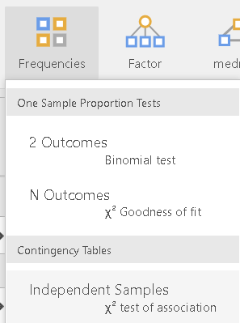
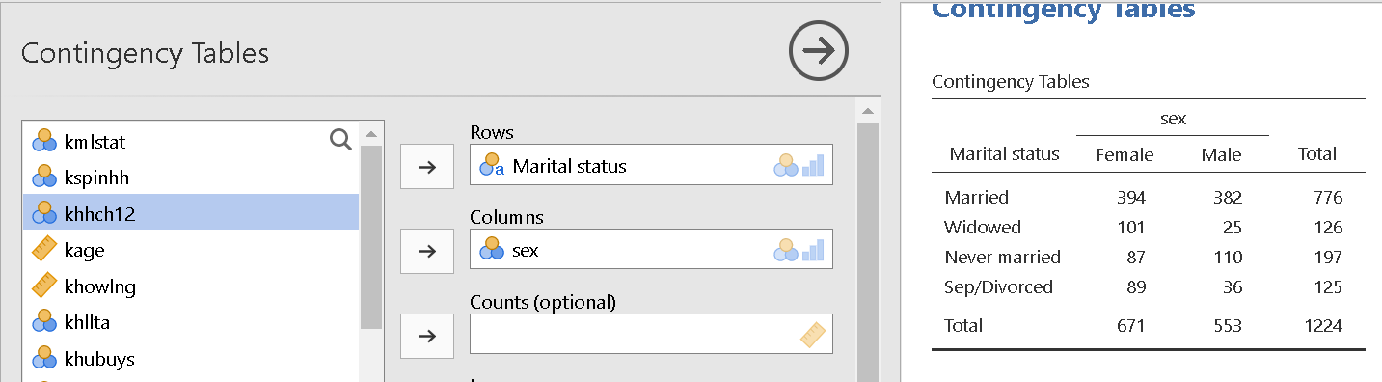
Check frequencies of combinations
Check the frequencies in each combination of gender and marital status
Consider reducing the number of categories where frequencies are small
The minimum group size here is 25 which is fine.
If you have small frequencies for some groups, watch the recoding groups video to find out how to exclude or combine categories before carrying out the ANOVA

Slide 7
Two-way ANOVA in Jamovi (part 2)
Video: https://screencast-o-matic.com/watch/c3iYj4VZejQ
Associated videos: One way ANOVA and Checking assumptions in Jamovi, Introduction to two way ANOVA
Ellen Marshall
Statistics support coordinator
Website and resources: https://maths.shu.ac.uk/mathshelp/resources.html

Slide 8
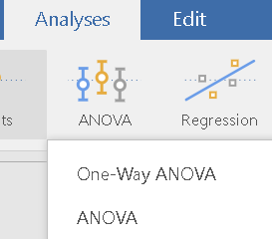
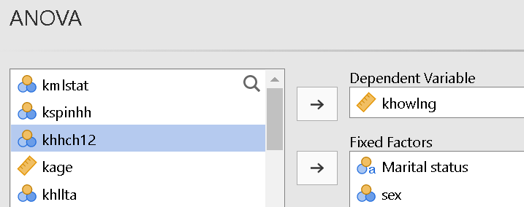
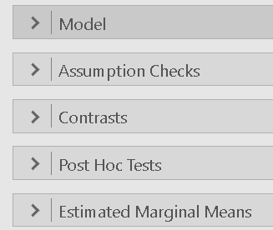
Two-way ANOVA in Jamovi
Move the continuous dependent to the ‘Dependent Variable’ box and the two categorical independent variables to the ‘Fixed Factors’ box
Watch this video for checking the assumptions for ANOVA
Post hoc tests test every pair of categories to see which groups are significantly different to each other
Obtain means and plots to describe differences

Slide 9
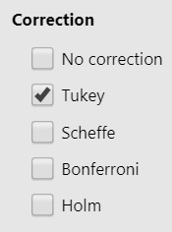
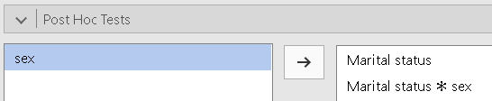
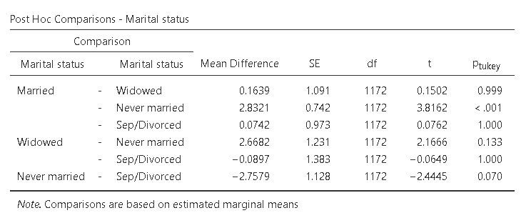
Post hoc (Pairwise) comparisons
Post hoc tests test pairs of categories for variables with more than two categories
Similar to independent t-tests but with adjustments for multiple tests
In the ‘Post hoc’ section, move the separate variables across and choose ‘Tukey’
Move independent variables with more than two categories
Look for significantly different pairs e.g. never married is significantly different to married (p<0.001). Married people do on average 2.8 hours more housework than those who have never been married after controlling for gender differences.

Slide 10
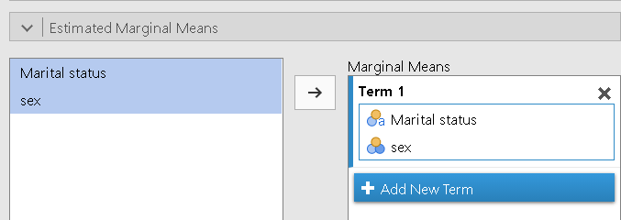
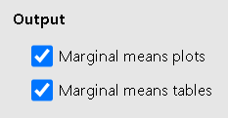
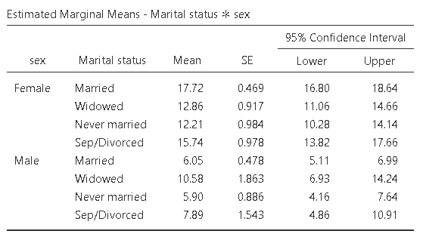
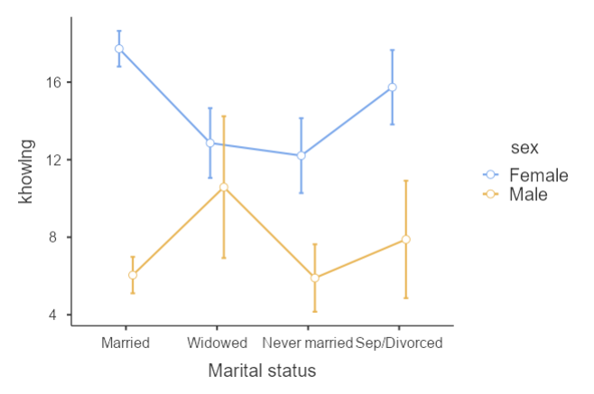
Interaction plot
To visualise the means of each combination, request an interaction plot through the marginal means menu
This plots the observed combination means
Move both variables at the same time
A confidence interval gives a range of values within which we think the true population mean for each groups lie

Slide 11
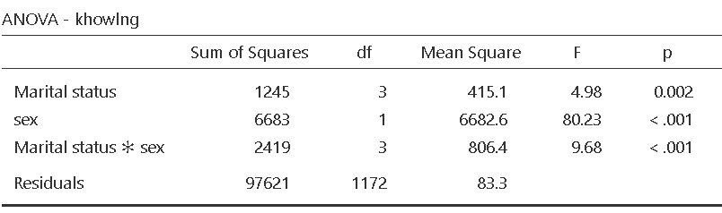
Two-way ANOVA main table
The tests control for the other variables when testing significance so results will differ from a one way ANOVA
Dependent = hours of housework Independents: marital status gender
Tests 3 hypotheses:
Main effects
Mean hours of housework does not differ by marital status
Mean hours of housework does not differ by gender
Interaction/combined/moderating effect
There is no interaction between marital status and gender
Which are significant?

Slide 12

Is the interaction significant?
If the interaction IS significant, you cannot interpret the main effects
Significant interaction: Use an interaction plot and specific post hoc tests to investigate different patterns
If the interaction IS NOT significant, interpret the effects of marital status and gender separately. Some people remove the interaction term and rerun the analysis
Use post hoc tests for individual variables and graphs to explain differences
The interaction is significant here but we’ll demonstrate both options

Slide 13

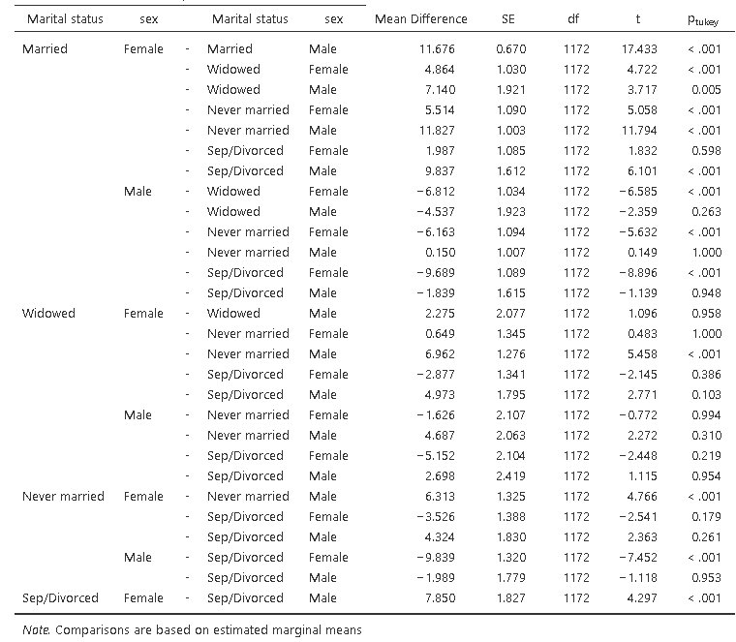
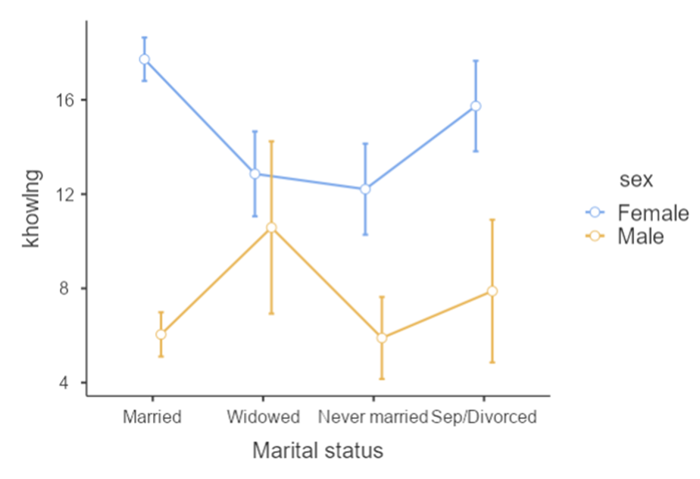
Significant interaction: Post hoc tests
If you wish to test which combinations are significantly, you can use the post hoc tests but the table can be very large and difficult to summarise.
Using the interaction plot on it’s own gives a better visual representation of differences

Slide 14
Significant interaction reporting
Figure 1: Interaction plot of hours of housework by marital status and gender
When the interaction is significant, report the ANOVA results for the interaction and discuss the plot. You may wish to include the ANOVA table in a report but it’s not essential
A two-way ANOVA was used to test whether marital status and gender impact on weekly hours of housework. There was a significant interaction [F(3,1172)=9.68, p<0.001] between gender and marital status.
As Figure 1 shows, females generally do more housework but the gap is very small for widowed people and largest for those who are married.
Table 1: two-way ANOVA results of hours of housework by marital status and gender

Slide 15
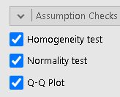
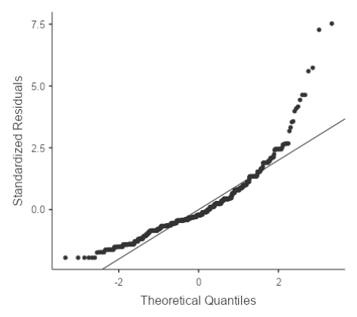
Checking assumptions
Two-way ANOVA has the same assumptions as one way
Watch the checking assumptions in ANOVA video
Use the QQplot to check normality of residuals
If the residuals are very skewed, there is no non-parametric alternative
Check for an interaction. If there is an interaction effect, do separate Kruskal-Wallis tests for marital status for males and females
If there is no interaction,
test variables separately Kruskal-Wallis tests

Slide 16
Two-way ANOVA in Jamovi (Part 3)
Interpretation when the interaction is NOT significant
Video: https://screencast-o-matic.com/watch/c3iYQfVZel7
Watch the preceding videos before this on: Part 1 and Part 2
Ellen Marshall
Statistics support coordinator
Website and resources: https://maths.shu.ac.uk/mathshelp/resources.html

Slide 17
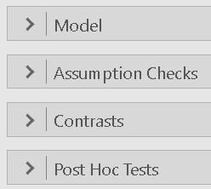
Interpret main effects
If the interaction IS NOT significant, use means to explain differences & carry out post hoc tests for variables with 3+categories
The tests control for the other variable when testing significance so results will differ from a one way ANOVA
Here both main effects of marital status and gender are significant after controlling for the other
If the interaction is not significant, you can remove the interaction term in the ‘Model’ menu but check what is standard practice in your discipline

Slide 18
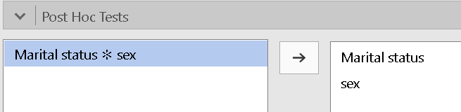
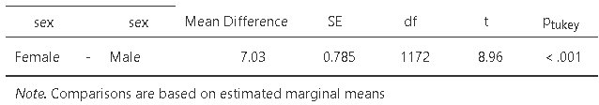
Post hoc (Pairwise) comparisons
In the ‘Post hoc’ section, move the separate variables across and choose ‘Tukey’
Move separate variables
Females do significantly more housework (7 hours more on average)
Never married is significantly different to married (p<0.001) after controlling for gender differences within the categories. Married people do on average 2.8 hours more housework than those who have never been married after controlling for gender differences.

Slide 19
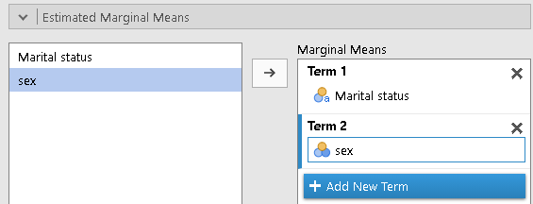
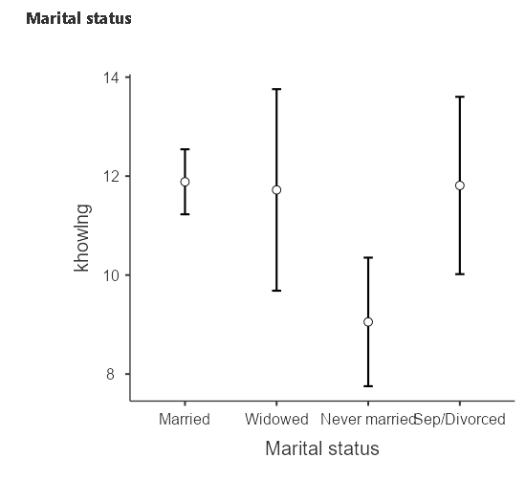
Charts
Use either the interaction plot to describe differences or individual plots for significant variables
The plot below generalises across both genders
Move variables as separate terms for separate plots
This plot shows estimated marginal means which take account of gender differences within the marital groups. These are not the same as the means in the data or results from a one way ANOVA.
Mean for all widowed

Slide 20

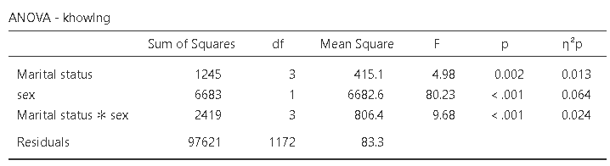


Effect size
The larger the sample size, the greater the chance of significant results
Effect sizes measure the degree of association between an effect and the dependent variable
Use partial eta-squared $\left(η^{2}p\right)$ for each effect in two way ANOVA
Effect size : small 0.01, medium 0.06, large 0.14
Small effect size for marital status $η^{2}p$=0.013
but gender has a moderate effect size

Slide 21
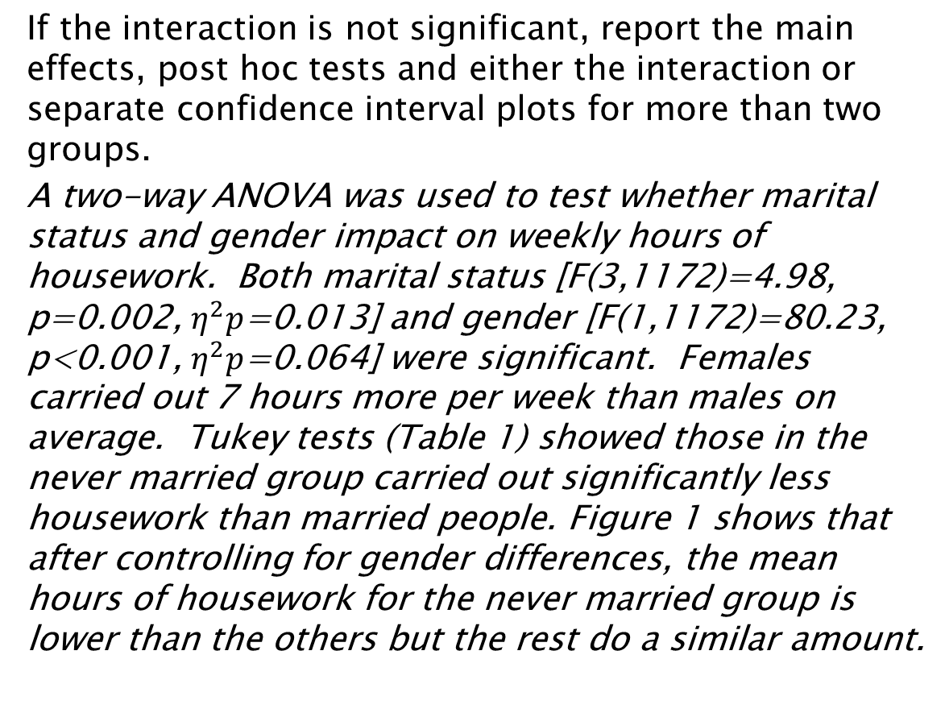
Main effects reporting
Figure 1: 95% CI plot of hours of housework marginal means by marital status
If the interaction is not significant, report the main effects, post hoc tests and either the interaction or separate confidence interval plots for more than two groups.
A two-way ANOVA was used to test whether marital status and gender impact on weekly hours of housework. Both marital status [F(3,1172)=4.98, p=0.002, $η^{2}p$=0.013] and gender [F(1,1172)=80.23, p<0.001, $η^{2}p$=0.064] were significant. Females carried out 7 hours more per week than males on average. Tukey tests (Table 1) showed those in the never married group carried out significantly less housework than married people. Figure 1 shows that after controlling for gender differences, the mean hours of housework for the never married group is lower than the others but the rest do a similar amount.
Table 1: Post hoc tests for marital status after controlling for gender

Slide 22
Checking assumptions
Two-way ANOVA has the same assumptions as one way
Watch the checking assumptions in ANOVA video
Use the QQplot to check normality of residuals
If the residuals are very skewed, there is no non-parametric alternative
Check for an interaction. If there is an interaction effect, do separate Kruskal-Wallis tests for marital status for males and females
If there is no interaction,
test variables separately using Kruskal-Wallis tests

Slide 23
Factorial ANOVA
You can add as many categorical dependents as you like
Always check the frequencies for categories and missing values
Look at group means for all the independents rather than throwing everything in
If you only have binary variables, use regression
Like regression, other variables are controlled by testing additional SS explained
Marginal means are adjusted for controls
If you have some continuous variables, use ANCOVA
If you want to test the effect of the same categorical independents on a group of related dependents, use MANOVA

Slide 24
ANOVA in Jamovi
Checking the assumptions
Video: https://screencast-o-matic.com/watch/c3iq1TV0Wpy
Ellen Marshall
Statistics support coordinator
Website and resources: https://maths.shu.ac.uk/mathshelp/resources.html

Slide 25
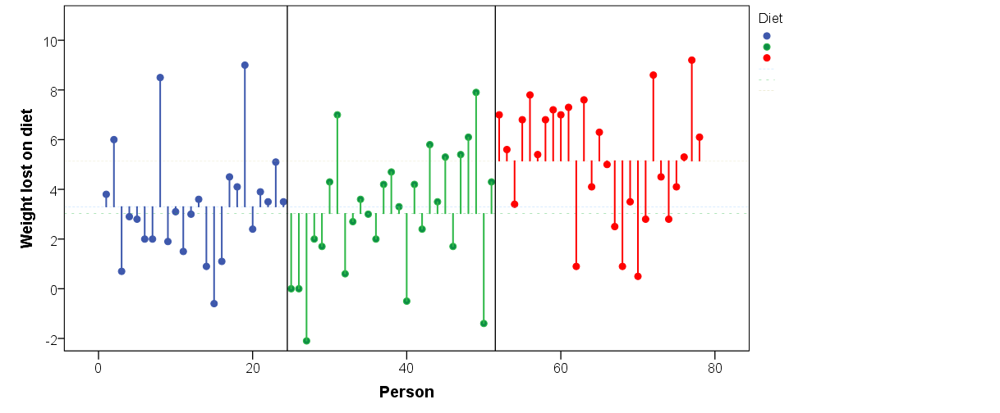
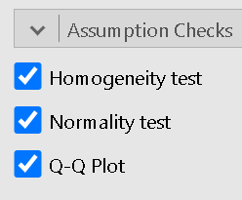

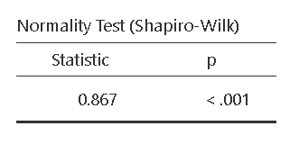
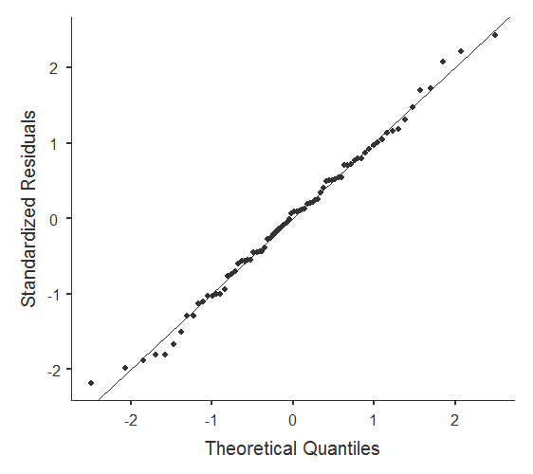
Assumptions
The assumptions are similar to the independent t-test and regression
Checks are found in the ‘Assumption checks’ menu
Normality: Residuals (differences between each observation and it's group mean) should be approximately normal
Homogeneity (Equality of variance): Standard deviations should be similar for the groups. Levene’s test
Shapiro-Wilk and QQ plots are used to check normality

Slide 26
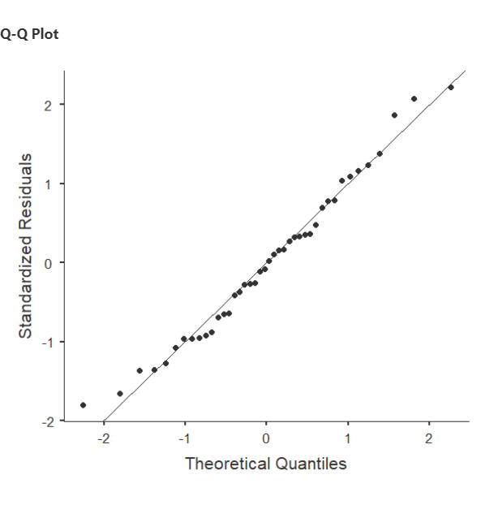
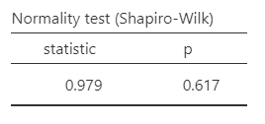
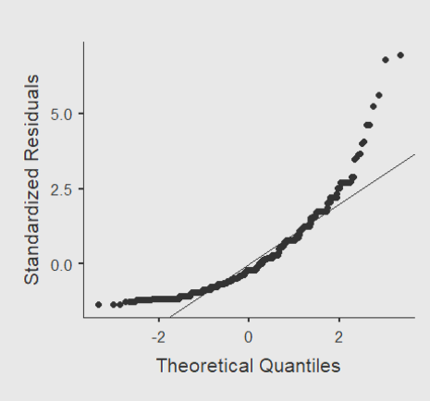
Residual checks - normality
approximately normally distributed
QQ Plot: The line is a perfect normal distribution
The closer the points are to the line the better
Skewed data will have scatter which curves away from the line at one or both ends
Residuals have to be very skewed to be a problem
Shapiro-Wilk is a test for normality
If p < 0.05, evidence data is not normal
very skewed
Warning: The Shapiro-Wilk is sensitive to sample size and outliers. Large samples will give significant results when the data are fine. Always check the chart as well

Slide 27
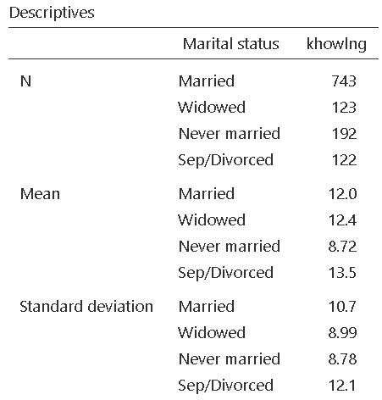
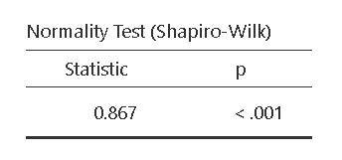
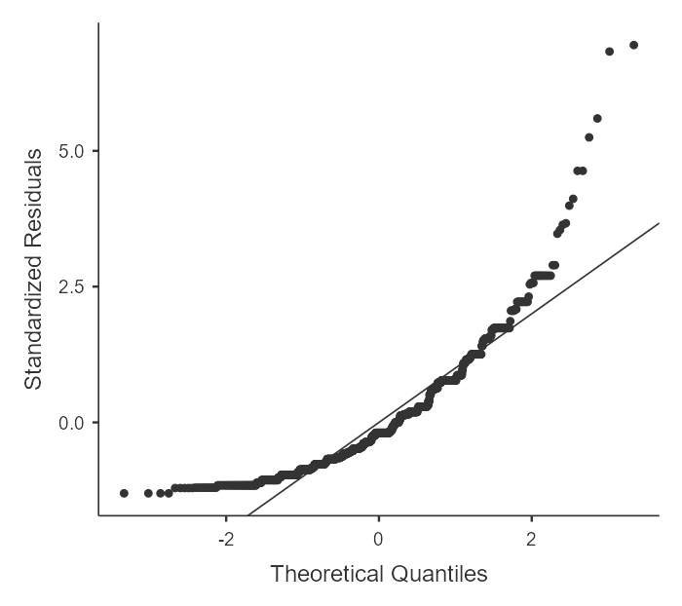
Marital status example
The example from the ANOVA video looks at the average hours of housework carried out by different housework groups
Residuals: Difference between each observation and group mean
The residuals are very skewed so use the non-parametric Kruskal-Wallis test or transform the dependent variable

Slide 28
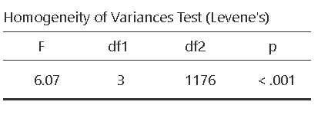
Assumptions: Equal variances
The variances (SD²) should be similar
Quick check: Is the largest SD more than twice the smallest?
Notice differences between SD’s not large
Levene’s test tests null: Variances are equal
Significant result means not equal
Levene’s oversensitive due to sample size
Always check the SD’s alongside the test

Slide 29
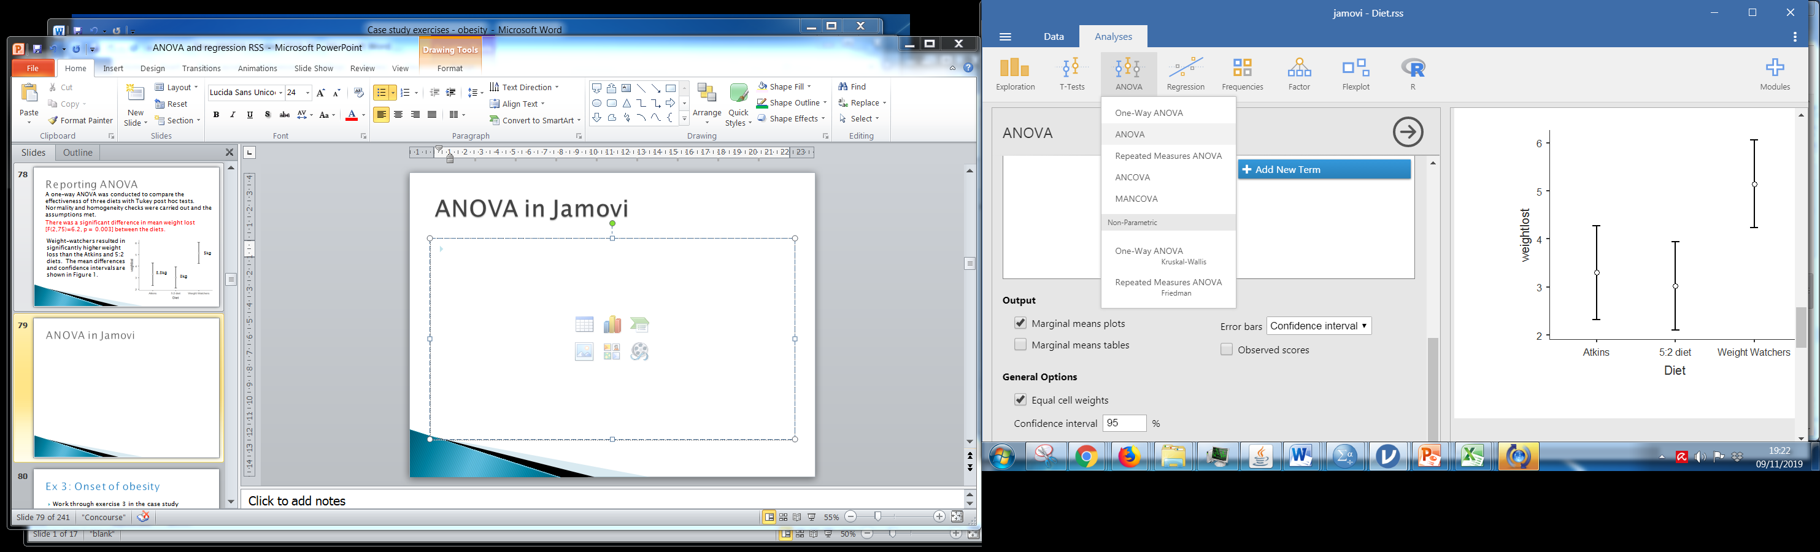
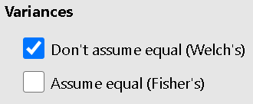
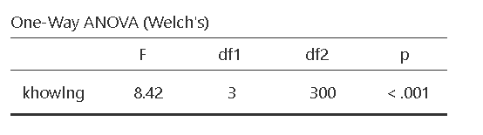
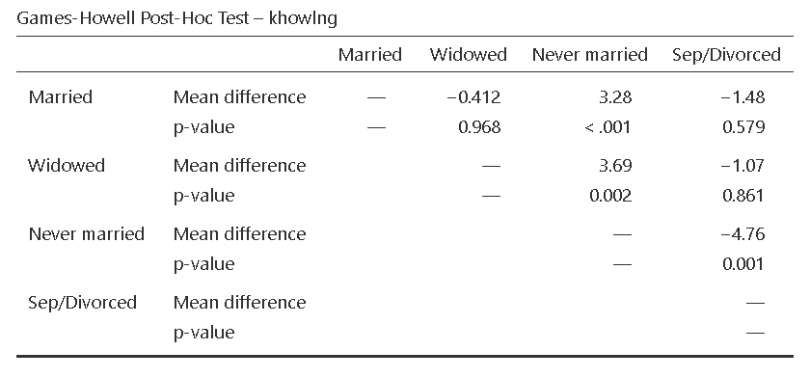
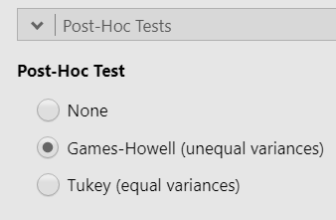
Equal variances
If the variances are really different, use Welch for the ANOVA and Games-Howell for post hoc tests
These are in the One-way ANOVA option

Slide 30
Comparing averages (one independent variable)
Normally distributed data (parametric tests)
Skewed or ordinal data (Non-parametric tests)
Independent sample t-test
Mann-Whitney
2 groups
Comparing BETWEEN groups
One way (between groups) ANOVA
Kruskal-Wallis
3+ groups
Paired t-test
Wilcoxon signed rank test
Comparing measurements WITHIN the same subject
2 time points/ conditions
3+
Repeated measures (within groups) ANOVA
Friedman
If you have two categorical independent variables, use a two way ANOVA
If you have repeated measurements and independent groups, use a mixed (between-within) ANOVA
Notes:
For comparing means ask two questions:
Are there repeated measurements of the same variable for each participant?
How many means are being compared? 2 = t-test, 3+ = ANOVA

